Slide 1
TMDB Movie EDA

Slide 2
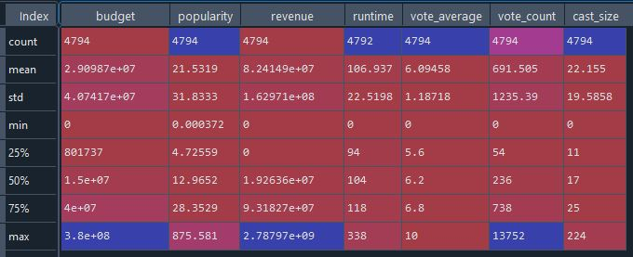
General Statistics

Slide 3
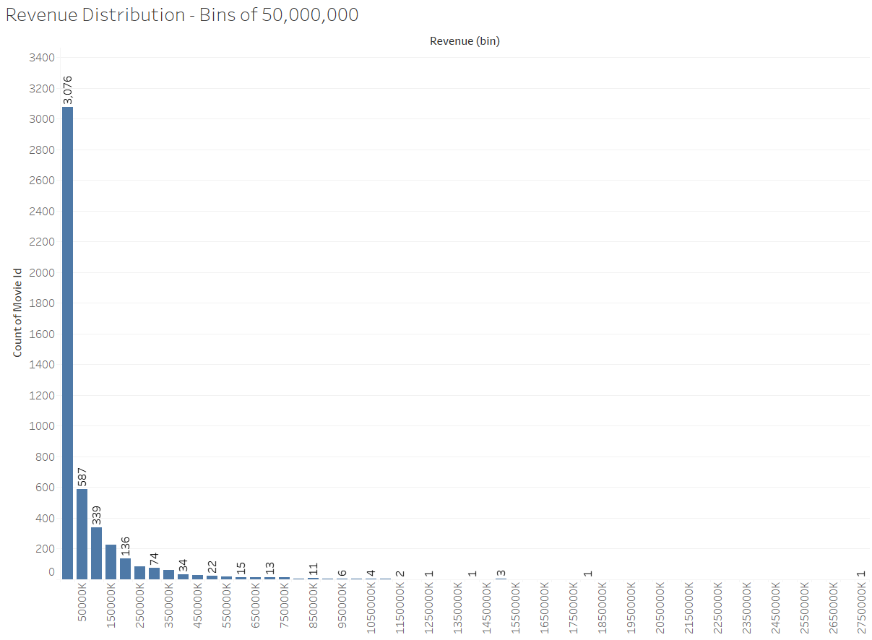
Revenue Distribution
1,419 movies have 0 revenue

Slide 4
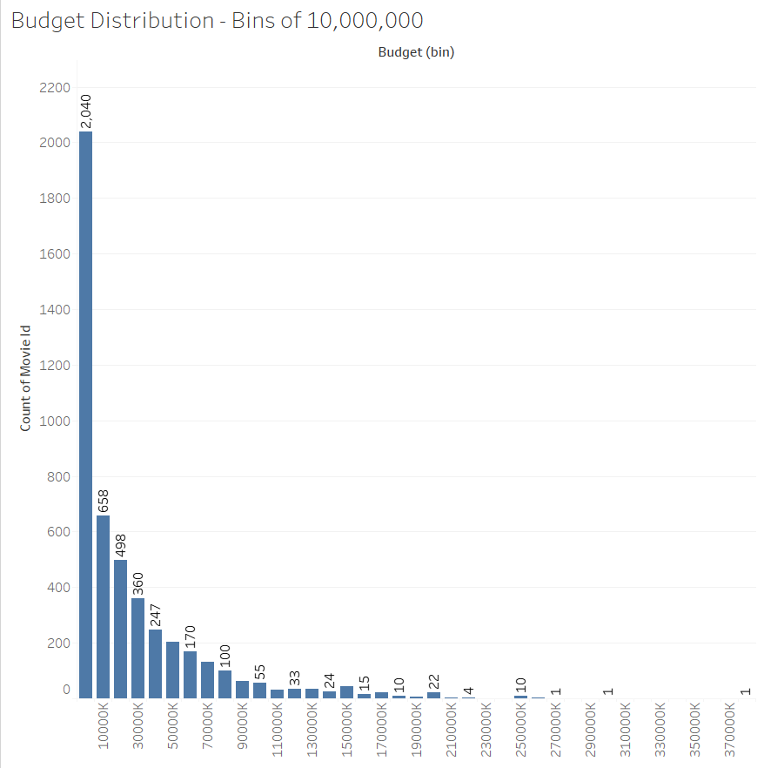
Budget Distribution
1,031 movies have 0 revenue

Slide 5
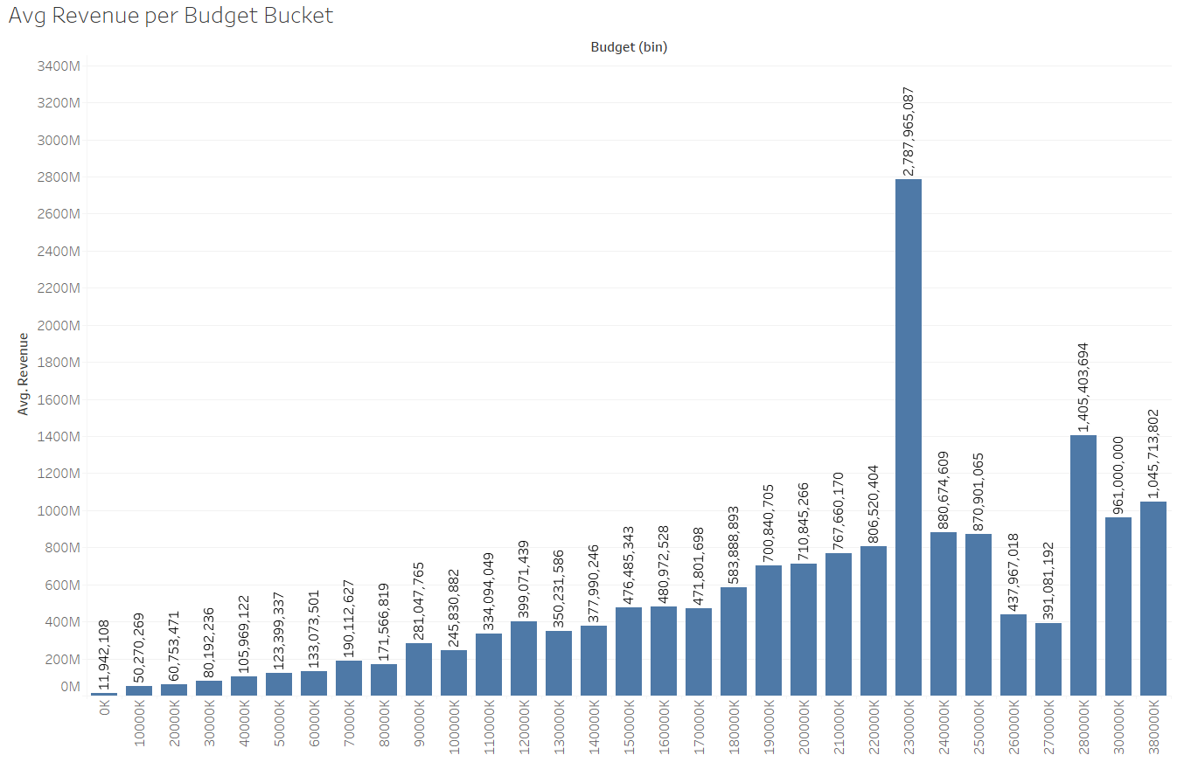
Avg Revenue per Budget Bin
230,000K bucket is only 1 movie

Slide 6
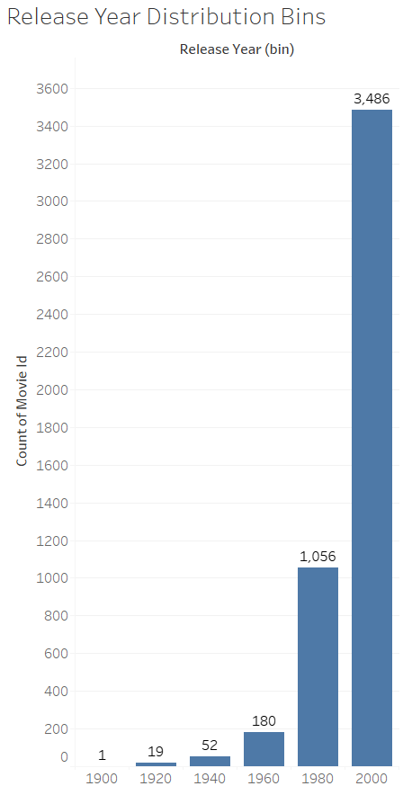
Count of Movies per Release Year

Slide 7
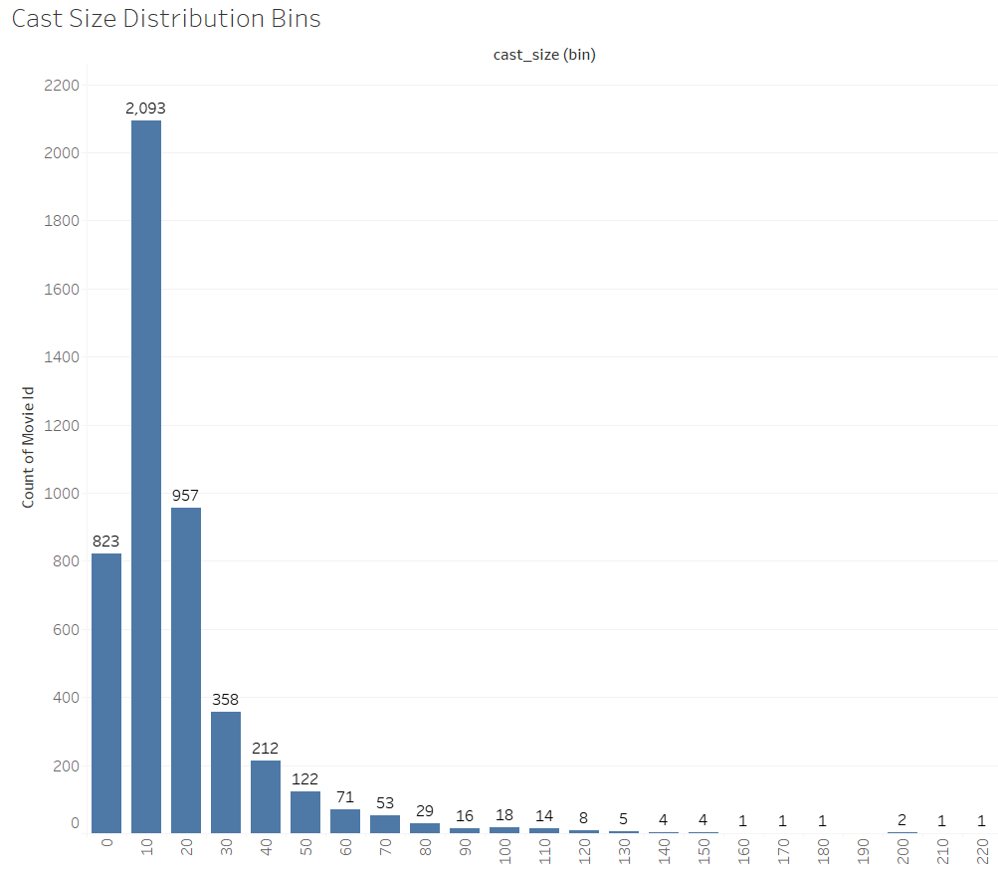
Cast Size Distribution
40 movies have 0 cast listed

Slide 8
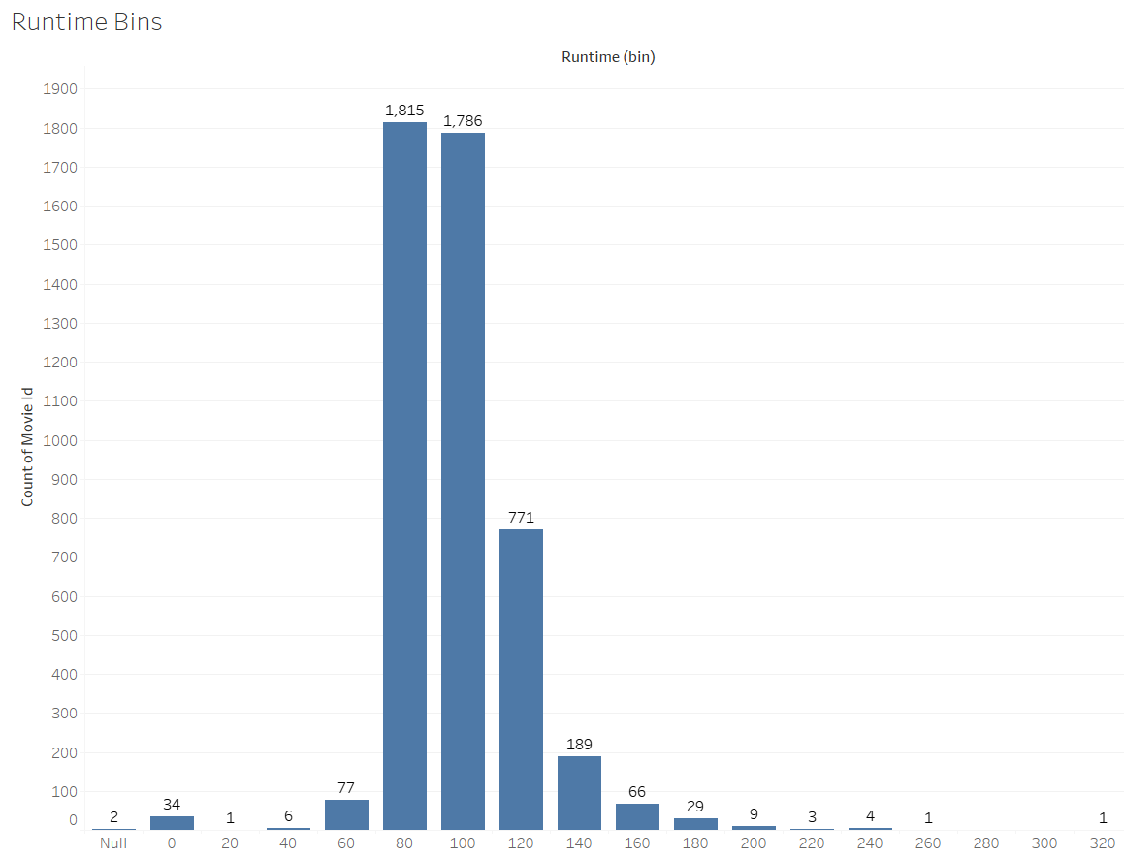
Runtime Distribution
35 movies have 0 as runtime

Slide 9
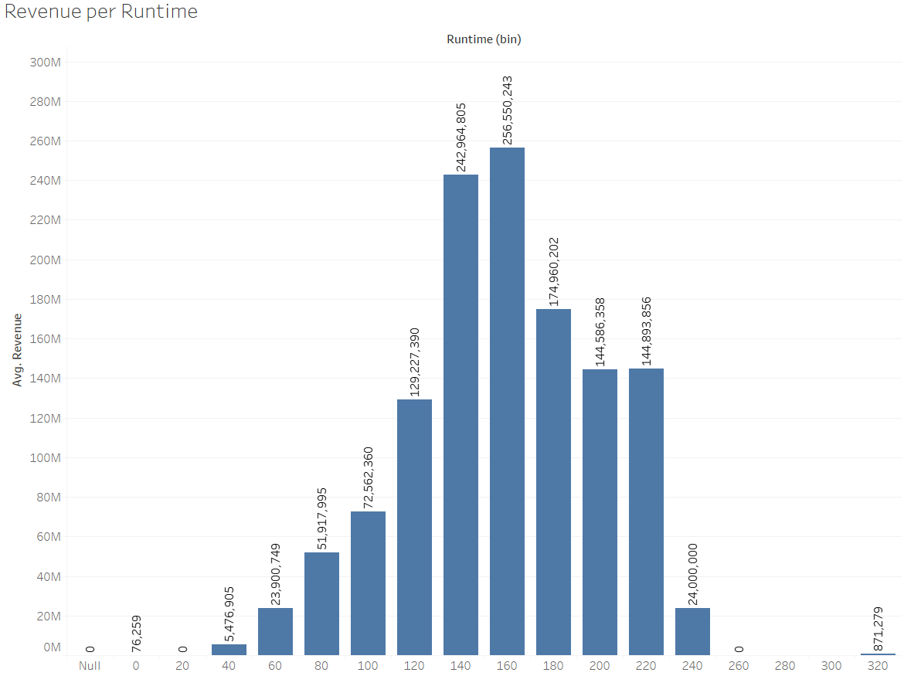
Revenue per Runtime

Slide 10
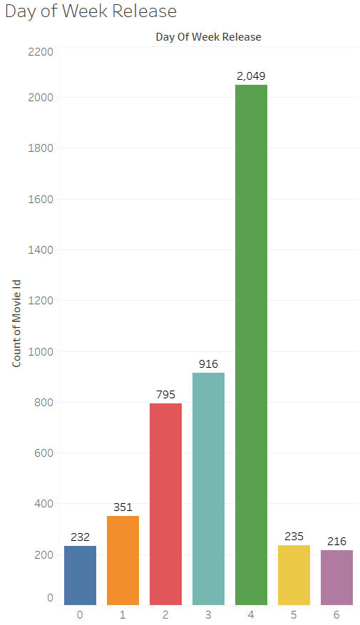
Day of Week Release
0 = Monday, 1 = Tuesday etc.

Slide 11
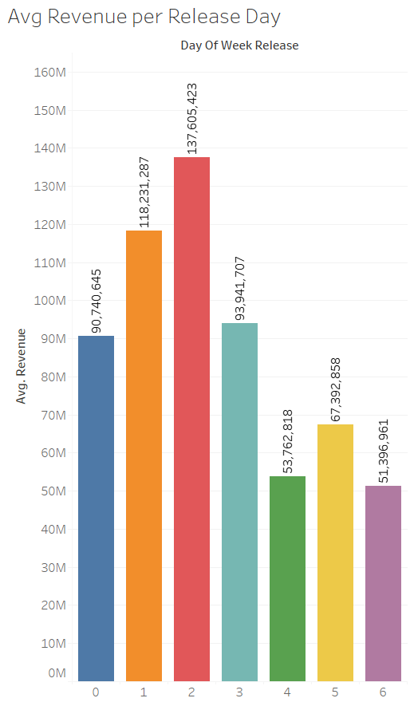
Avg Revenue per Release Day
0 = Monday, 1 = Tuesday etc.

Slide 12
Decisions to be made…
What years of movies?
How to handle movies with 0 budget?
How to handle movies with 0 revenue?
How to handle movies with 0 cast?
How to handle movies with 0 runtime?
GDP data source?
How to create “star power”?
Assign an attribute/weight to cast member name? Salary? Avg order etc.?

